Slide 1
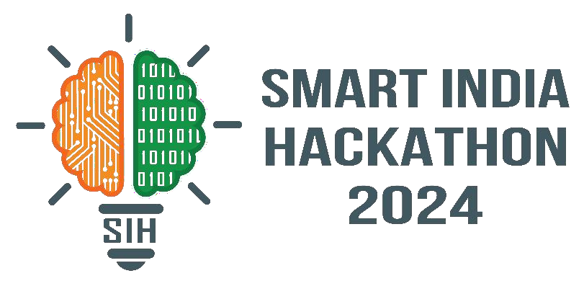

SMART INDIA HACKATHON 2024
TITLE PAGE
Problem Statement ID – 1597
Problem Statement Title- Student Innovation
Theme- MedTech / BioTech / HealthTech
PS Category- Software
Team ID-
Team Name (Registered on portal) – BYTE BUSTERS

Slide 2

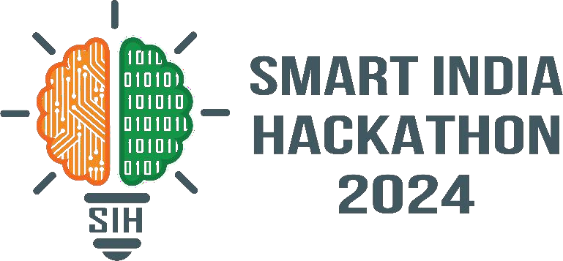
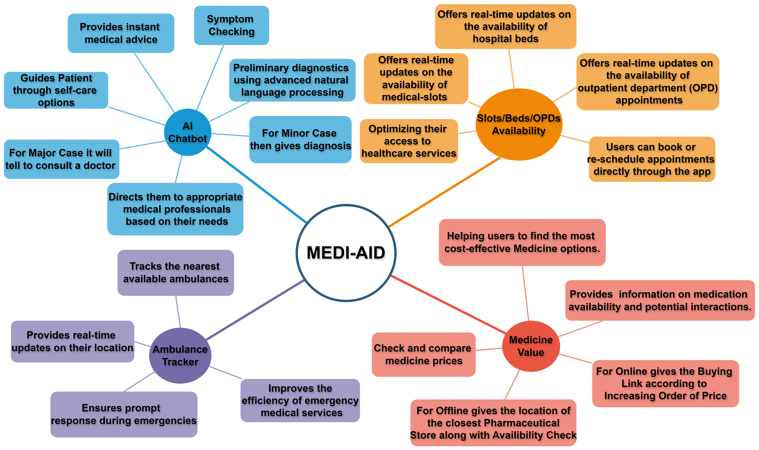
MEDIAID
Byte Busters
Proposed Solution (Describe your Idea/Solution/Prototype)

Slide 3







TECHNICAL APPROACH
Byte Busters
Technologies to be used:
Programming Languages:
Java/Flutter- for Android app development
Python- for Machine Learning and Data Analysis
Machine learning libraries:
PyTorch for building and training machine learning models
Geolocation and Mapping:
Google Maps API- for geolocation and mapping services
Data storage and management:
MySQL for storing patient data and medical records
Firebase for backend services and data management

Slide 4
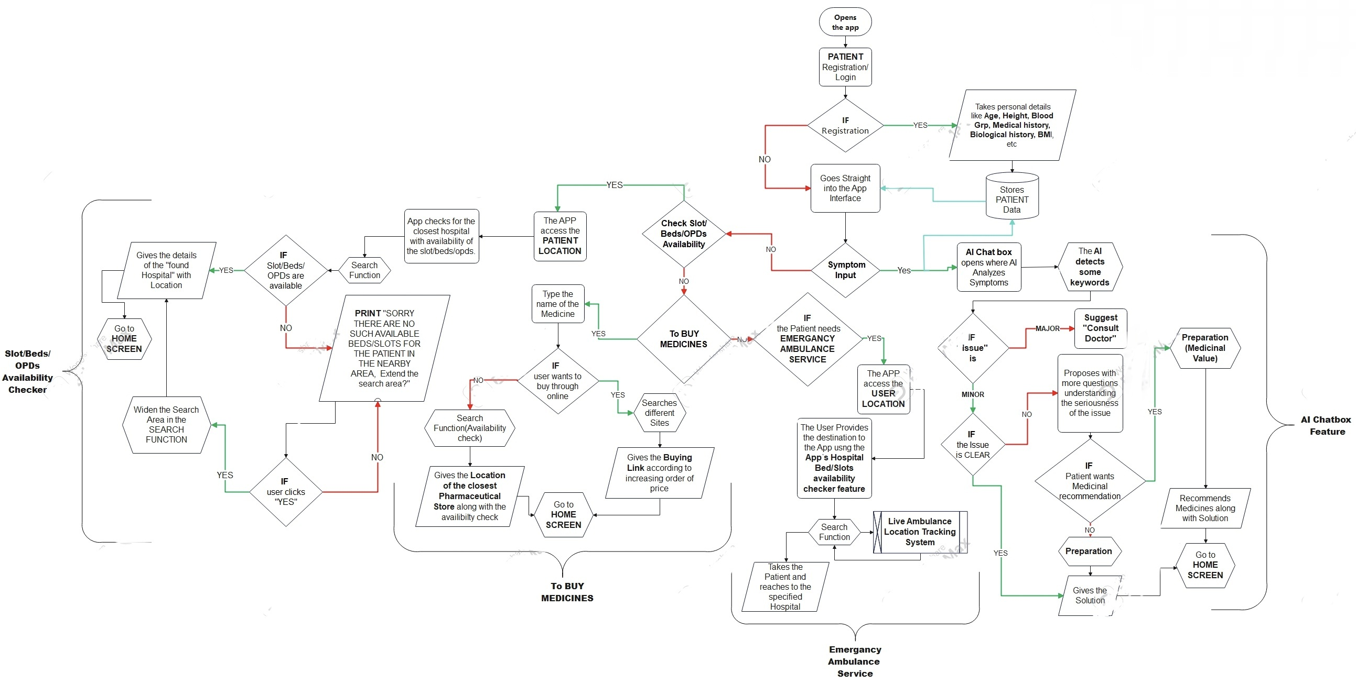

TECHNICAL APPROACH
Byte Busters
M ethodol o g y a n d p r o c e s s f o r i m p l e m e n t a t i o n ( F l o w charts/images/ working prototype) :
@SIH Idea submission- Template
4

Slide 5
FEASIBILITY AND VIABILITY
Byte Busters
Analysis of the feasibility of the idea:
Compatible for Android, IOS, and
Additionally can be implemented as web app for platform independency.
Potential challenges and risks:
Users will need high levels of accuracy and reliability to trust the app for critical decisions like bed availability, medicine recommendations, and ambulance tracking.
A data breach could expose sensitive health records, leading to a loss of trust and legal issues.
Strategies for overcoming these challenges:
Obtain Certifications and Adhere to Regulations ,Partnerships with Licensed Medical Professionals Implement Strong Security Protocols, Transparent Data Policies ,Regular Updates and Continuous Learning, Clear Disclaimers and Medical Oversight, Regular App Maintenance

Slide 6
IMPACT AND BENEFITS
Byte Busters
Potential impact on the target audience :Our app is useful for each and every people who needs any kind of medical help.
Benefits of the solution (social, economic, environmental, etc) :
24/7 AI Chatbot Assistance Ease of Booking Slots
Checking Availability Personalized
Medicine Recommendations
Ambulance Tracking for Emergency Situations
Better Management of Hospital Resources
Reduced Hospital Overcrowding
Informed Decision-Making Cost Savings for Patients and
Healthcare Systems
Faster Response in Emergencies
RESEARCH AND REFERENCES
Stanford University’s Medical AI Lab
Healthcare.gov
FDA Guidelines on AI in Medical Devices
Journal of Emergency Medical Services (JEMS)IEEE Xplore
To develop an app with these features, you will need to reference academic research, case studies, technical papers, and regulatory guidelines from reputable sources in AI, healthcare, and app development. It’s essential to stay up-to-date with the latest advancements and maintain compliance with local and global health regulations.

